Slide 1
Building HTTP Services
Session 09
Course : COMP6584001 – Network and Systems Programming
Ivan Sebastian Edbert

Slide 2
Learning Objectives
At the end of this session, the student will be expected to :
Able to explain anatomy of Go HTTP Server
Able to use Handlers
Understand about Middleware

Slide 3
Outline
Go HTTP Anatomy
Handlers
Middleware

Slide 4
Go HTTP Anatomy

Slide 5
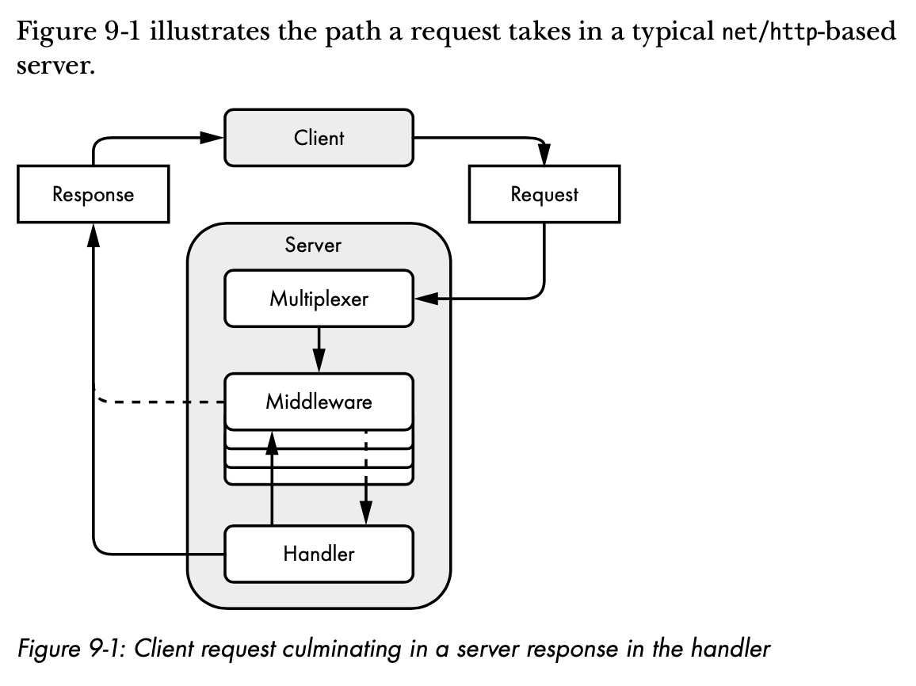
Anatomy Go http server
First, the server’s multiplexer (router, in computer-networking parlance) receives the client’s request.
The multiplexer determines the destination for the request, then passes it along to the object capable of handling it. We call this object a handler.
(The multiplexer itself is a handler that routes requests to the most appropriate handler.) Before the handler receives the request, the request may pass through one or more functions called middle- ware.
Middleware changes the handlers’ behavior or performs auxiliary tasks, such as logging, authentication, or access control.
Listing 9-1 creates an HTTP server that follows this basic structure.

Slide 6
handlers

Slide 7
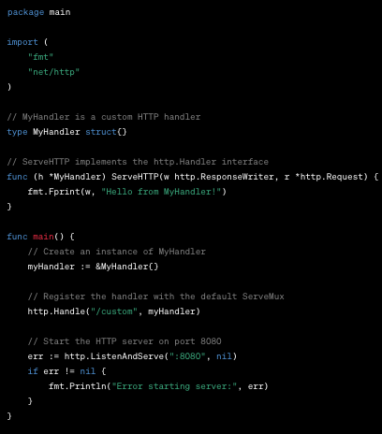
handlers
In Go's net/http package, a handler is an interface called http.Handler. It defines the ServeHTTP method, which allows an object to handle HTTP requests. When an HTTP request is received by a server, the server looks for a registered handler that can handle the request.
Here's a basic example of a custom handler:

Slide 8
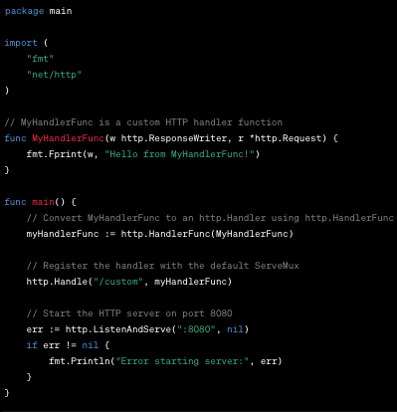
handlers
The MyHandler type implements the http.Handler interface by providing a ServeHTTP method. This method is called to handle incoming HTTP requests.
An instance of MyHandler is created (myHandler), and it's registered to handle requests with the pattern "/custom" using http.Handle("/custom", myHandler).
When a request with the path "/custom" is received, the ServeHTTP method of MyHandler is invoked to handle the request.
You can also use the http.HandlerFunc type to convert a function into an http.Handler. Here's an example:

Slide 9
handlers
In this example, MyHandlerFunc is a function that takes an http.ResponseWriter and an http.Request as parameters. The http.HandlerFunc type is used to convert this function into an http.Handler, and it is registered to handle requests with the pattern "/custom".
Handlers are a powerful concept in Go's net/http package, allowing you to create modular and reusable components for handling different types of HTTP requests.

Slide 10
middleware

Slide 11
middleware
What is middleware?
Middleware is software and cloud services that provide common services and capabilities to applications and help developers and operators build and deploy applications more efficiently. Middleware acts like the connective tissue between applications, data, and users.
Middleware has been part of software engineering terminology since the late 1960s, and as a category can apply to a wide range of modern software components. Middleware can include application runtimes, enterprise application integration and various kinds of cloud services. Data management, application services, messaging, authentication, and application programming interface (API) management are all commonly handled by middleware.

Slide 12
middleware
Why is middleware important
Middleware began as a bridge between new applications and old systems before gaining popularity in the 1980s. Developers initially used it to integrate new programs with previous systems without rewriting the previous code. Middleware has become an important communication and data management tool in distributed systems.
Developers use middleware to support application development and simplify the design process. This makes the developer free to focus on business logic and features rather than connectivity between different software components. Without middleware, the developer must build a data exchange module for each software component connected to the application. This is challenging because modern applications consist of several micro services or small software components that communicate with each other.

Slide 13
Middleware
Cases using middleware
Game Development
Game developers use middleware as a game engine. For the game to function, the software must communicate with various image, audio and video servers along with the communication system. Game machines facilitate this communication and make game development more efficient.
Electronic
Electronic technicians use middleware to integrate various types of sensors with their controls. The middleware layer allows sensors to communicate with controllers through a general messaging framework.
Software Development
Software developers use middleware to integrate different software components into other applications. Middleware offer Application Programming Interface (API) standards for managing input and output data needed from components. Internal links with components are hidden from the user. Developers use APIs to request the services needed from software components.

Slide 14
Middleware
Cases using middleware
Data transmission
Software applications use middleware to send and receive data flow reliably. Data flow is a high-speed continuous data transmission. Data flow is important for reliable video and audio streaming.
Distributed application
Distributed applications are software programs that run on different computers on a network. Distributed applications usually consist of frontend and backend applications. Frontend applications are software that you use on a computer or mobile device, such as social media applications. Instead, backend applications are software programs that handle data processing, business logic, and resource management tasks. Middleware communicates between frontend and backend applications, so distributed applications work smoothly.

Slide 15
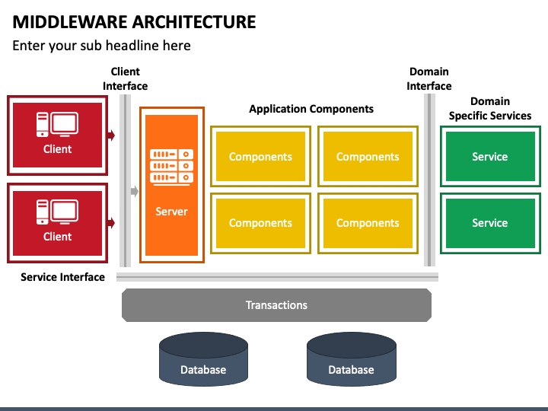
middleware
architecture

Slide 16
references
Adam Woodbeck - Network Programming with Go_ Learn to Code Secure and Reliable Network Services from Scratch-No Starch Press (2021).
https://www.ibm.com/docs/en/mam/7.6.1.2?topic=properties-http-handler
https://www.redhat.com/en/topics/middleware/what-is-middleware#:~:text=Middleware%20is%20software%20and%20cloud,applications%2C%20data%2C%20and%20users
https://aws.amazon.com/id/what-is/middleware/

Slide 17
Thankyou

